Slide 1
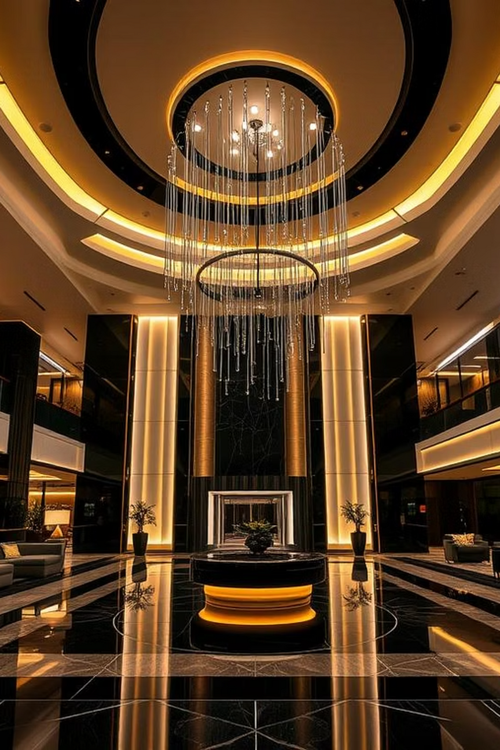
Hotel Booking Data Analysis
Team Members:
Hazem Elsheikh
Moaz Mohammed
Mostafa Saad
Cellula Technologies
Machine Learning Internship
Week 2

Slide 2
Data Preprocessing

Slide 3
Data Preprocessing
Hazem
Moaz
Mostafa
Cleaned and standardized column names
Removed irrelevant column: ‘booking_id’
Dropped duplicate rows
Fixed invalid date entry in ‘date_of_reservation’
Converted date column to datetime format
Made sure that there were no missing data
Converted date of reservation to datetime
Removed missing values and duplicates
Standardized column names
Removed rows with missing values (dropna())
Converted date of reservation to datetime
Standardized column names by stripping whitespace
Dropped irrelevant column: Booking_ID
Verified data types and cleaned formats

Slide 5
Outliers

Slide 6
Outliers
Hazem
Moaz
Mostafa
Visualized numeric features using boxplots
Used Histograms to see the normal distribution
Decided to only focus on the outliers for “lead time”
used log transform to handle its outliers
Checked the lead time skew before and after the transformation
the transformed lead time was closer to be normally distributed
Visualized numeric features using boxplots
Handled outliers with IQR focusing in lead time feature
Visualized outliers using boxplots and distribution plots
Handled outliers with IQR capping

Slide 8
Feature Engineering

Slide 9
Feature Engineering
Hazem
Moaz
Mostafa
Encoded “booking_status” to binary
(Canceled = 0, Not_Canceled = 1)
One-hot encoded “market_segment_type”
Combined features:
all_people = adults + children
all_nights = weekend + week nights
Created new flags:
has_previous_cancelation: (binary flag from p-c)
booking_ratio = p-c / (p-c + p-not-c)
Converted categorial columns into numerical:
“room_type”
“type_of_mean”
Encoded target variable booking status to binary
Applied Label Encoding and One-Hot Encoding where needed
Feature selection done using:
SelectKBest with chi2
mutual_info_classif
Scaled numerical features using StandardScaler
Encoded target variable booking status to binary
Applied Label Encoding and One-Hot Encoding where needed
Created new features:
Dropped unused columns: Booking_ID, date of reservation
Removed highly correlated features (correlation > 0.85
Handled class imbalance using SMOTE.
Scaled features using StandardScaler.

Slide 11
Modeling

Slide 12
Modeling
Hazem
Moaz
Mostafa
Created a logistics regression model
Choose the final features to be used for the model
Checked multicollinearity with VIF
did not actually remove the features with high VIF value
Performed train/test split
train = 0.8
test =0.2
Evaluated model using:
Accuracy Score
Accuracy = 0.81
Classification Report
Confusion Matrix
Cross-validation scores
Score = 0.8
Models used:
Logistic Regression
Random Forest
Gradient Boosting
Support Vector Machine (SVM)
Evaluated using:
Accuracy Score
Confusion Matrix
ROC-AUC Score
Classification Report
Performed Cross-Validation and GridSearchCV for tuning
Models used:
Logistic Regression
Random Forest
Evaluated using:
Accuracy Score
Confusion Matrix
Classification Report

Slide 14
Thank You

